Slide 1

MES 503 Lab 11
Kayla Blincow, PhD

Slide 2

Announcements
No class on Monday!
Quiz next Wednesday!
Lab 4 due tomorrow!
Next week bring your own dataset to work with
Happy Halloweeeeennn!

Slide 3

What type of test would you use with a categorical explanatory variable and a categorical response variable?

Slide 4

Enter Analysis of Frequencies!

Slide 5


What is a frequency?
counts of observations that fall into categories

Slide 6
Types of Questions
Does my distribution of frequencies across each category match the expected distribution across categories?
Does the distribution of frequencies across one categorical variable affect the distribution of frequencies across another categorial variable?
What is the likelihood that two distributions of frequencies come from the same population?

Slide 7
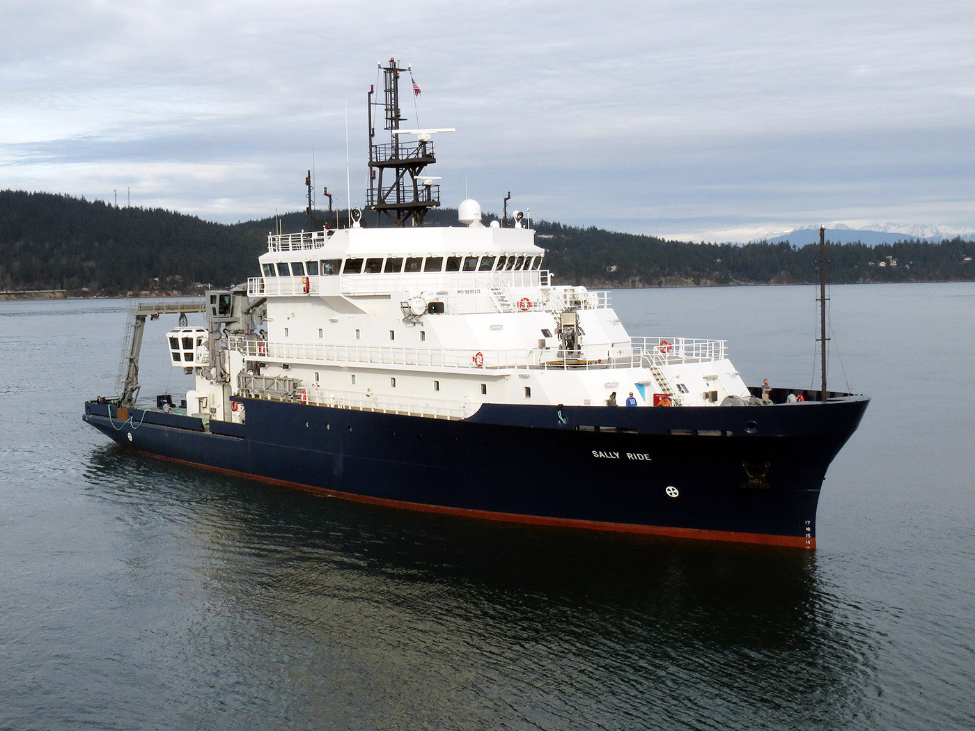
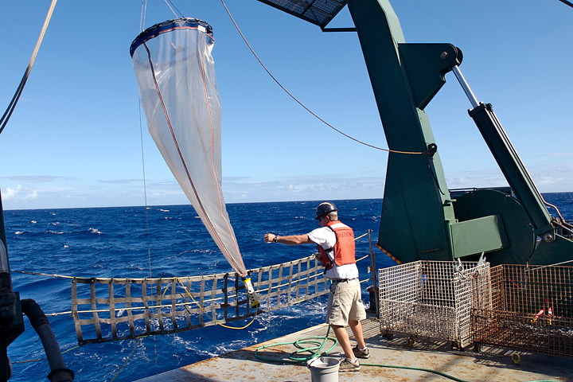
Research Scenario!
We are doing some big ship science!
Sample copepods during an El Nino year
Count the number of each group

Slide 8
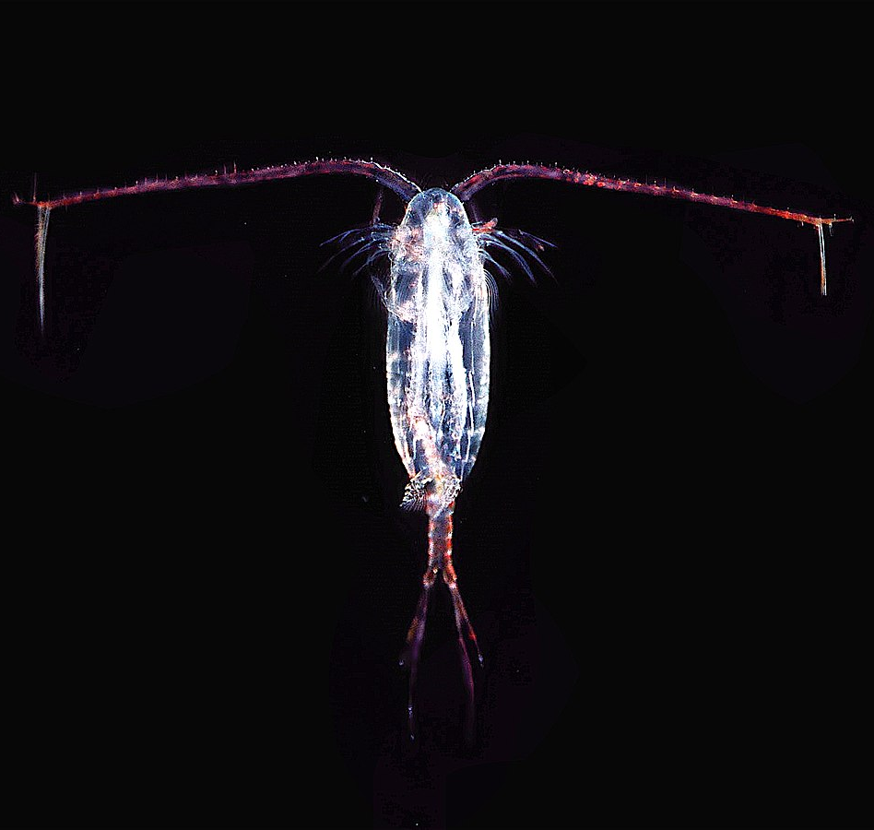
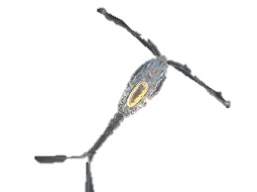
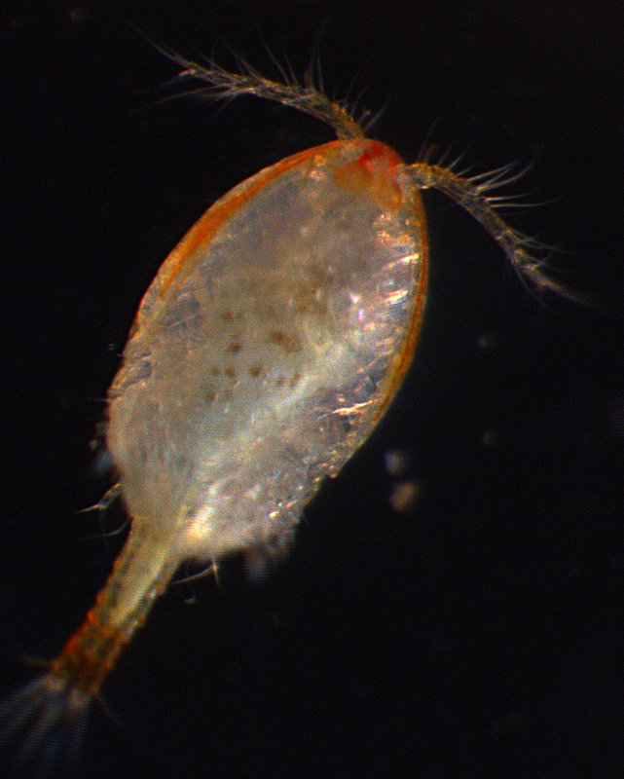
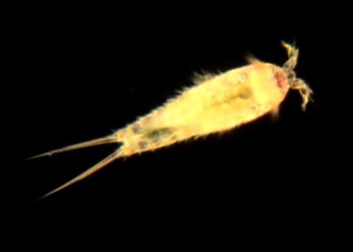
Meet the Copepods!
Calanoid
Harpacticoid
Cyclopoid
Poecilostomatoid
*note: apparently poecilotomes are now a suborder of cyclopoids, but we are ignoring that for the purposes of this lecture

Slide 9

Blackwater Manor
Coding Escape Room
Notes:
In this activity, you need to solve a series of scientific puzzles using your data science skills in R. Start by navigating to the website provided and working your way through the clues, using the datasets and instructions available in each room. You'll need to open your own R/RStudio environment to explore the data, write and run code, analyze results, and determine the correct answers to progress. You are encouraged to work in groups.
Work together, discuss your approaches, and use evidence from your analyses to guide your decisions. Each solved puzzle will unlock the next stage of the activity. Your goal is to solve all the clues, complete the investigation, and discover where the data lead you!
Good luck, and remember: think critically, trust the data, and show your work!

Slide 10

https://kmblincow-the-blackwater-manor-incident.share.connect.posit.cloud/

